Slide 1


JAVA Java Interview boot camp Core concepts
Lecture 20
CHAPTER 41
CoccurrentHashMap

Slide 2
concurrenthashmap
(Internal Working!)

Slide 3
What Is ConcurrentHashMap ?
The ConcurrentHashMap is a class introduced in JDK 5.0 under the package java.util.concurrent
It provides a concurrent version of the standard HashMap.
So its functionality is similar to a HashMap, except that it has internally maintained concurrency

Slide 4
What Is Concurrency ?
Concurrency is the ability to run several parts of a program in parallel.
It enables a program to achieve high performance and throughput by utilizing capabilities of underlying operating system and machine hardware.

Slide 5
What Is Concurrency ?
For e.g. modern computers have several CPU’s or several cores within one CPU.
So a concurrent program can utilize all cores for some part of processing; thus completing task much before in time in comparison to sequential processing

Slide 6
What Makes A Java Application Concurrent ?
To develop a concurrent application in Java we require the class java.lang.Thread .
This class is the basis of all concurrency concepts in Java.

Slide 7
What Makes A Java Application Concurrent ?
We also use an interface called java.lang.Runnable to abstract the thread behavior out of Thread class.
And to build advance applications we require classes found in the package java.util.concurrent , which was added in Java 1.5

Slide 8
What Are The Reasons To Use ConcurrentHashMap In Concurrent Apps ?
The 2 main reasons of using ConcurrentHashMap in a concurrent application are:
Performance
And
Thread Safety

Slide 9
Will HashMap Not Give Performance ?
No.
HashMap will solve performance issue by giving parallel access to multiple threads.
But HashMap is not thread safe, so what will happen if two threads try to put data and moreover , suppose at the same time Rehashing is required ?
It will cause data inconsistency

Slide 10
Can’t We Use Hashtable or SynchronizedMap() In This Case ?
No.
Hashtable or SynchronizedMap() can provide Thread Safety but performance wise it is very poor
This is because they provide concurrent access to the Map.Entries objects by locking the entire map to perform any sort of operation (update,delete,read,create).

Slide 11
How ConcurrentHashMap Solves This Issue ?
ConcurrentHashMap is internally divided into segments and it only locks a particular segment instead of locking the whole Map.
This is called BucketLevel Locking

Slide 12
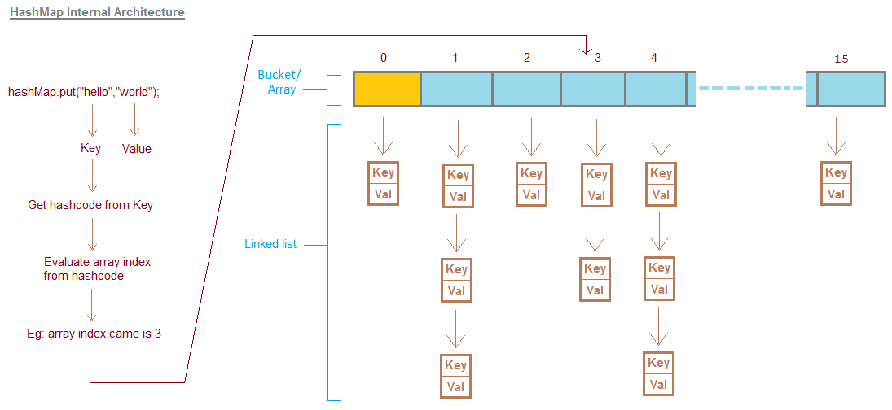
Internal Structure Of HashMap

Slide 13
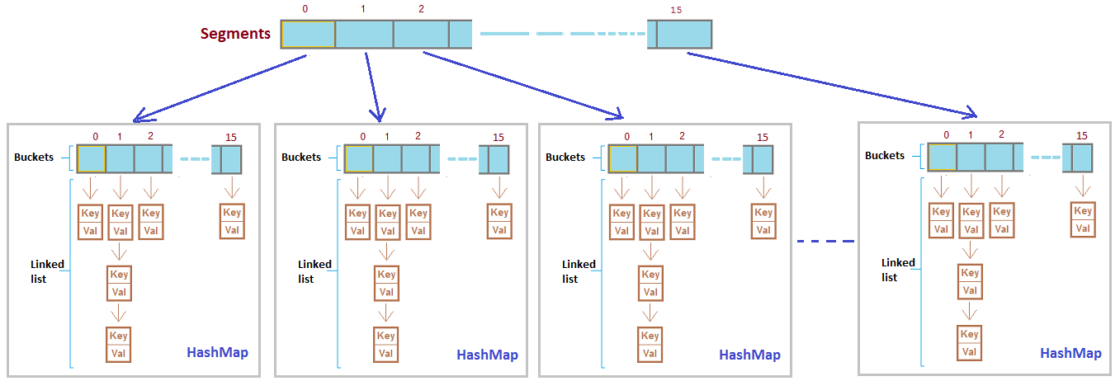
Internal Structure Of ConcurrentHashMap

Slide 14
How ConcurrentHashMap Is Efficient ?
ConcurrentHashMap provides better performance by replacing the Hashtable's map wide lock to Segment level lock.
Hashtable is not efficient because it uses map wide lock, it means lock is applied on map object itself,

Slide 15
How ConcurrentHashMap Is Efficient ?
So if 2 threads tries to call hashtable.get(key),
Thread T1 calls to get() method will acquire a lock on hashtable object and then execute get() method. (Lock is on complete 'hashtable object')
Now if Thread T2 calls hashtable.get(key) method, then it will also try to acquire lock on hashtable object, but T2 will not able to acquire lock as lock on 'hashtable' is currently held by T1,
So T2 waits until T1 finishes get() operation and releases lock on hashtable object.

Slide 16
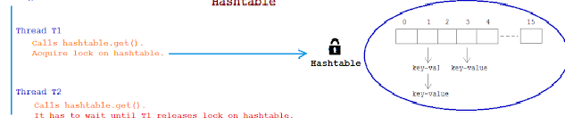
How ConcurrentHashMap Is Efficient ?

Slide 17
How ConcurrentHashMap Is Efficient ?
ConcurrentHashMap works bit different here and instead of locking complete map object it locks per Segment.
It means instead of single map wide lock, it has multiple Segment level lock.

Slide 18
How ConcurrentHashMap Is Efficient ?
So 2 Threads can execute put operation simultaneously by acquiring lock on different Segments.
Thread T1 calls concurrentHashMap.put(key, value), It acquires lock on say Segment 1 and invokes put method.
Thread T2 calls concurrentHashMap.put(key, value), It acquires lock on say Segment 4 and invokes put method.
Both threads doesn't interfere with each other and both can proceed simultaneously as they are working on separate Segment locks.

Slide 19
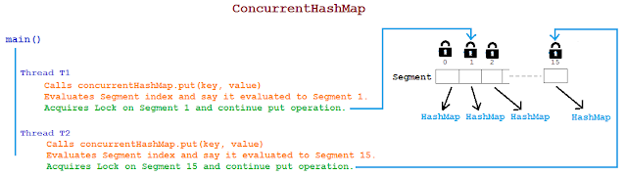
How ConcurrentHashMap Is Efficient ?

Slide 20
Can multiple threads read and write from same or different Segments of ConcurrentHashMap simultaneously?
Read Operation: get(key)
Same Segment/Different Segment : Yes.
Two threads T1 and T2 both can simultaneously read data from same Segment or different Segment of CHM simultaneously without blocking each other.

Slide 21
Can multiple threads read and write from same or different Segments of ConcurrentHashMap simultaneously?
Write Operation: put(key, value)
Different Segment :Yes
Multiple threads can write data to different Segment of CHM simultaneously without blocking each other.
Same Segment : No
Multiple threads CANNOT write data to same Segment of CHM simultaneously and need to wait for one thread to complete write operation and then only other write operation can be proceed.

Slide 22
Can multiple threads read and write from same or different Segments of ConcurrentHashMap simultaneously?
Read-Write Operation: get and put
Say T1 is writing data in Segment 1 and T2 is reading data from same Segment 1, can read be allowed while writing operation is going on?
YES.
Both operation that is T1 writing and T2 reading can be done parallely.

Slide 23
Can multiple threads read and write from same or different Segments of ConcurrentHashMap simultaneously?
What data will T2 read if T1 is updating same data?
Retrieval operations (including get) generally do not block, so may overlap with update operations (including put and remove).
Latest updated value present will be returned by get operation that is value updated by most recently completed update operations will be returned.

Slide 24
What is the default size of Segment array? What is ConcurrenyLevel in case of CHM?
Default size of Segment array is 16.
ConcurrentHashMap differs from Hashtable in terms of performance by introducing Segment array.
Each index of Segment array is guarded by a lock for put() operation.

Slide 25
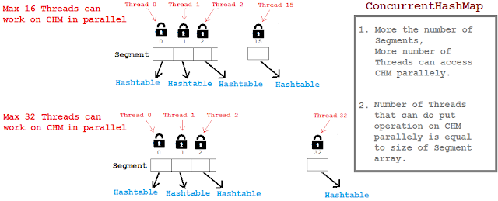
What is the default size of Segment array? What is ConcurrenyLevel in case of CHM?

Slide 26
How Segment Size Can Be Tuned ?
Segment size decides the number of Threads that can paralley write to ConcurrentHashMap.
Segment array size is configured using ConcurrencyLevel parameter as shown below:
ConcurrentHashMap m = new ConcurrentHashMap(initialCapacity, loadFactor, concurrencyLevel)

Slide 27
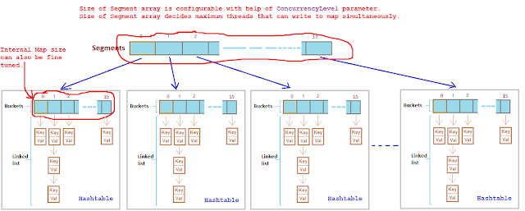
How Segment Size Can Be Tuned ?

Slide 28
How Segment Size Can Be Tuned ?
It takes 3 parameters:
Example:
ConcurrentHashMap m = new ConcurrentHashMap(200 , 0.75f, 10);
Initial capacity is 200, it means CHM make sure it has space for adding 200 key-value pairs after creation.
Load factor is 0.75, it means when average number of elements per map exceeds 150 (intital capacity * load factor = 200 * 0.75 = 150) at that time map size will be increased and existing items in map are rehashed to put in new larger size map.
Concurrency level is 10, it means at any given point of time Segment array size will be 10 or greater than 10, so that 10 threads can able to parallely write to a map.

Slide 29
If we choose ConcurrenyLevel as 10 then what will be size of Segment array? Is Segment array size exactly same as concurrenyLevel? If No, then how is the Segment array size calculated?
Segment array size is calculated based on concurrenyLevel specified but it doesn't mean it will be exactly same as concurrenyLevel.
If concurrenyLevel is 10 then Segment array size will be 16.

Slide 30
If we choose ConcurrenyLevel as 10 then what will be size of Segment array? Is Segment array size exactly same as concurrenyLevel? If No, then how is the Segment array size calculated?
Segment array size = 2 to the power x, where result should be >= concurrenyLevel(in our case it is 10)
Segment array size = 2 to the power x >= 10
Segment array size = 2 ^ 1 = 2 >= 10 (False)
Segment array size = 2 ^ 2 = 4 >= 10 (False)
Segment array size = 2 ^ 3 = 8 >= 10 (False)
Segment array size = 2 ^ 4 = 16 >= 10 (True)
Segment array size is 16.
Example: 2
concurrenyLevel = 8 then Segment array size = ?
2 ^ 3 >= 8
Segment array size will be 8.

Slide 31
What is HashEntry array and how is the size of HashEntry decided?
Default initial capacity of CHM is 16.
It means CHM makes sure there is sufficient space to accomodate 16 key-value pairs after CHM is created.
These key-value pair entries are called HashEntry

Slide 32
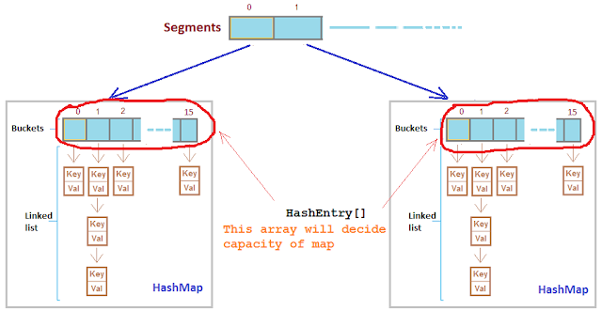
What is HashEntry array and how is the size of HashEntry decided?
In HashMap the bucket/array is of type Entry[] and in CHM the array is of type HashEntry[].

Slide 33
What is HashEntry array and how is the size of HashEntry decided?
HashEntry[] array size = 2 ^ x >= (initialCapacity / concurrenyLevel)
Eg: ConcurrentHashMap(32, 0.75f, 4);
HashEntry[] array size = 2 ^ 1 = 2 >= 8(32/4) (False)
HashEntry[] array size = 2 ^ 2 = 4 >= 8 (False)
HashEntry[] array size = 2 ^ 3 = 8 >= 8 (True)
HashEntry[] array size = 8.
It means there will always be capacity of 8 key-value pairs that can be put in CHM after its creation.

Slide 34
Does ConcurrentHashMap Allow null key or values ?
Although a HashMap allows maximum one null key and any number of null values but ConcurrentHashMap doesn’t allow even a single null key and a null value.

Slide 35
What Type Of Iterator Does ConcurrentHashMap Offers ?
Iterators returned by HashMap are fail-fast in nature.
Because they throw ConcurrentModificationException if the map is modified while iterating using iterator.
Where as iterators returned by ConcurrentHashMap are fail-safe in nature.
They don’t throw any exceptions if the map is modified while iterating using iterator.

Slide 36
Performance Wise How Is ConcurrentHashap compared To HashMap ?
Only modifying operations on ConcurrentHashMap are synchronized.
Hence, add or remove operations on ConcurrentHashMap are slower than on HashMap.
The read operations on both, ConcurrentHashMap and HashMap, give same performance as read operations on both maps are not synchronized.

Slide 37
When To Use What ?
As ConcurrentHashMap is internally synchronized and hence it is most suitable for concurrent multi threaded applications.
HashMap is not synchronized internally and it is most suitable for single threaded applications.

Slide 38
Sample Code
import java.util.Map;
import java.util.concurrent.ConcurrentHashMap;
public class CHMExample {
public static void main(String[] args) {
// Creating ConcurrentHashMap
Map<String, String> carMap = new ConcurrentHashMap<String, String>();
// Storing elements
carMap.put("1", "Audi");
carMap.put("2", "BMW");
carMap.put("3", "Jaguar");
carMap.put("4", "Mini Cooper");
for (Map.Entry<String, String> entry : carMap.entrySet()) {
System.out.println("key- " + entry.getKey() + " value- " + entry.getValue());
}
}
}

Slide 39
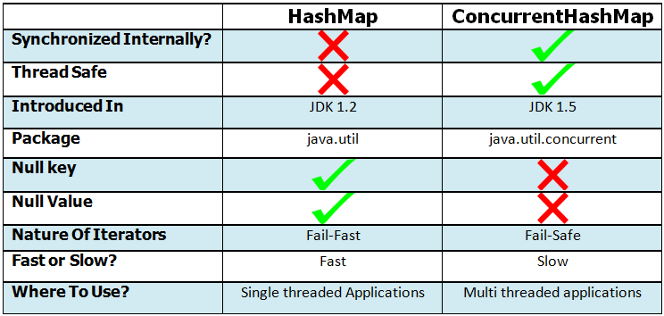
Comparison

